Slide 1
Module 1: Lesson x – Planting and Seeding Equipment
Notes:
This lesson is going to be a very brief overview/discussion on the different types of seed planting equipment that is available today and their uses. This is by no means an exhaustive list, every

Slide 2
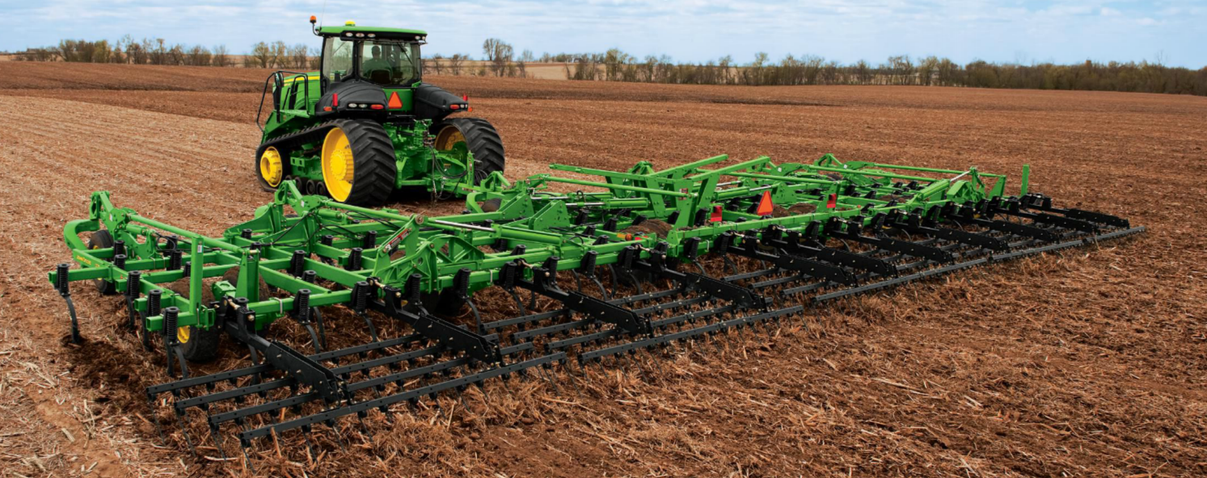
Introduction: What is Tillage?
Tillage is the mechanical disturbance of the soil in preparation for planting
Purpose
Seedbed Preparation
Weed Control
Residue Management
Soil Aeration

